Slide 1
TITLE:
Retail Performance Insights: Revenue & Customer Behavior
Online Retail | Power BI | 2010–2011

Slide 2
Agenda
Introduction
Building confidence
Engaging the audience
Visual aids
Final tips & takeaways

Slide 3
Business Objective
Understand overall retail performance using transaction data
Identify revenue drivers (time, products, customers, countries)
Support data-driven business decisions using dashboards

Slide 4
Dataset Overview
Dataset: Online Retail (Dec 2010 – Dec 2011)
Cleaned transactional data
Key fields:
InvoiceDate
CustomerID
Quantity
Revenue
Country

Slide 5
Key Business KPIs
Total Revenue: 10.62M
Total Transactions: 21K
Average Order Value: 512.40
Total Customers: 4,339

Slide 6
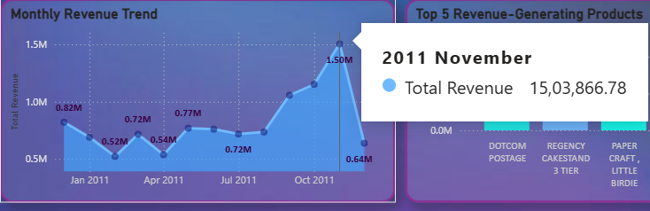
Monthly Revenue Trend
Revenue shows steady growth through 2011
Peak revenue observed in November
Slight drop in December due to partial month data

Slide 7
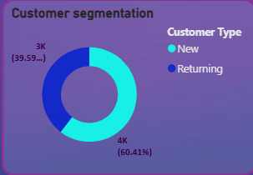
Customer Segmentation: New vs Returning Customers
Customers are segmented into New and Returning based on purchase history.
New customers form the majority (≈60%), indicating strong customer acquisition.
Returning customers account for ≈40%, showing moderate retention.
This analysis focuses on customer volume, not revenue contribution.

Slide 8
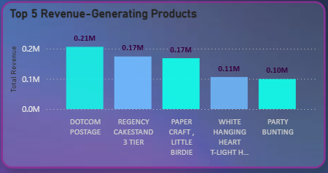
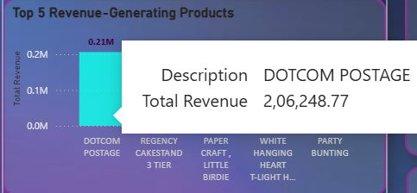
Top Revenue-Generating Products
A small number of products contribute most revenue
Example: Top 5 products dominate sales
Business Insight: Focus promotions and stock planning on high-revenue products.

Slide 9
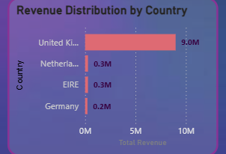
Geographic Performance
United Kingdom contributes the highest revenue
Other countries contribute significantly smaller shares
Business Insight: Primary market is UK → opportunity to expand internationally.

Slide 10
Hypothesis Formulation
Hypothesis :
H₀ (Null Hypothesis): There is no significant difference between new and returning customers in terms of average order value.
H₁ (Alternative Hypothesis): There is a significant difference between new and returning customers in terms of average order value.

Slide 11
Hypothesis Testing & Business Insight
Method :
Metric used: Average Order Value
Groups compared: New vs Returning customers
Test type: Independent comparison (conceptual t-test)
Result :
A difference in purchasing behavior is observed between customer groups.
Returning customers tend to place repeat purchases, while new customers dominate in volume.

Slide 12
Business Insight :
High share of new customers shows strong acquisition.
Lower returning customer count suggests retention strategies can improve long-term revenue.
Focus areas:
Loyalty programs
Personalized offers
Repeat purchase incentives

Slide 13
THANK YOU!!

